Slide 1

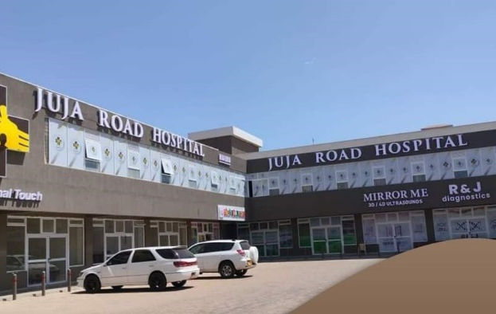
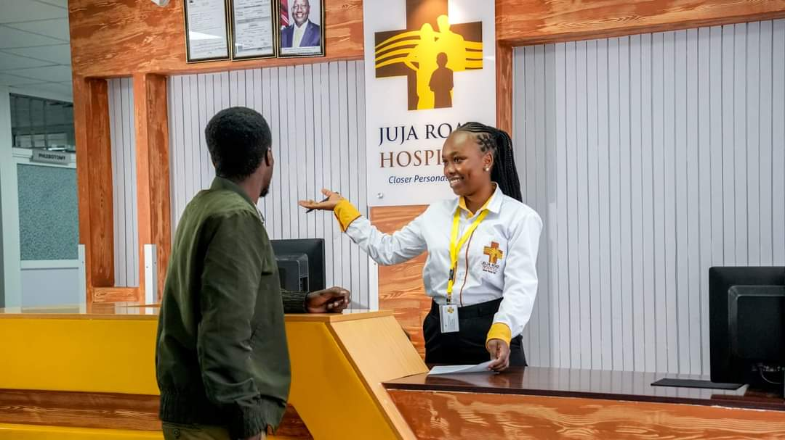
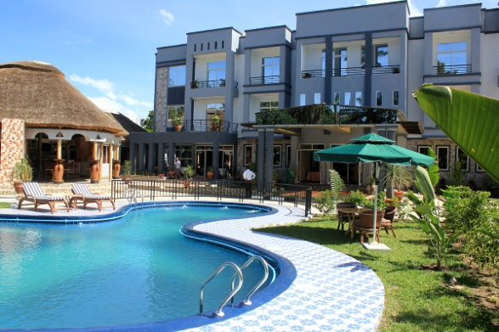
Renaissance Per Salut Architects
Architecture Reborn
Architects, Interior Designers and Project Managers
Company Profile
www.rpsa.co.ke
RENAISSANCE PER SALUT ARCHITECTS,
Brandon Ethan House, Ngara
KolobotRoad ,
P.O Box 152– 00515
Nairobi, Kenya
Tel: +254 721286228,+254 735975898

Slide 2
Renaissance is proud to have highly qualified and competent multidisciplinary staff and consultants with specialisations in the fields of Housing, Health facilities design , Project Management, Urban Design and Urban management. This specialised and multidisciplinary approach to practice enriches project design and implementation . We pride in ourselves as a one stop shop with in house consultants for Quantity Surveying, Civil Structural as well as Electro mechanical engineering
Vision
Our vision is to provide innovative yet practical and applicable planning and design solutions.
Mission Statement
By creatively exploiting the available technology and knowledge, we strive to ensure every design solution is practical and applicable in the everyday situation. This is achieved through
· Proper Harnessing of Information Technology
· Learning from day to day activities and applying them accordingly
· Interaction with and involvement of clients in the design process.
· Meeting human needs through functional design solutions
Project Scope
We have undertaken various Architectural projects as a company and individual directors have also been involved in projects, which can be outlined as
· Architectural Consultancy
· Planning and design
· Production drawings
· Project supervision
· Contract administration
· Research and Feasibility studies and Project Reports
· Environmental Impact assessment
· Project management
· Interior Design
· Environmental Impact Assesment

Slide 3
Brief Profile of Director
STAFF PROFILE( cvs available on request)
KEY STAFF
Arch Robinson Manguro - Director
Denis Mbugua - Architect
Kelvin Ngei - Graduate Architect
Frank Chumo - Site Supervision Manager
Godfred Achieng - Architectural Technician
Gregory Ngétich - Draughtsman
Harun Shisia - Project Manager
Irene Kimeu - Admin Assistant
Victor Oruko - Acccountant
CONSULTANTS
Eng Duncan Amol - Civil / Structural Engineer
Arch Aboubaida Altigan - Architect
Eng Johnson Rimba - Mechanical Engineer
Eng Sam Sikoa -Electrical Engineer
QS Francis Mbugua - Quantity Surveyor
Introduction
Renaissance per Salut Architects is a dynamic architectural practice incorporated in Kenya and committed to excellence in the building industry in Africa. We strive to ensure that our projects are environmentally sensitive , cost effective and spatially efficient and that they offer value to our Clients’ investments. Renaissance staff enjoy a cumulative experience of over 30 years standing in project practice and have undertaken projects of varying complexity ranging from residential , health, commercial , institutional and hospitality projects to diverse clients both locally and internationally. Our projects assert the importance of sustainable design in building projects through the adoption of renewable energy sources, building recycling systems and building energy efficient systems. At Renaissance, we believe in context sensitive designs that maximise on indoor comfort through taking advantage of natural ventilation systems , natural lighting systems , use of locally available materials and innovative landscaping interventions.
At Renaissance Africa , we deeply treasure and cherish the values of honesty , hard work and trustworthiness in the projects we undertake. We seek to create an open and transparent environment for the free expression of professional minds in the design and implementation of projects .As a our Client , you can find confidence in our commitment and determination to meet your vision and aspirations in your various projects and an assured partner in the successful implementation of your projects.

Slide 4
ORGANOGRAM
DIRECTOR
SENIOR ARCHITECT
CONSULTANTS
HEAD OF ADMIN
ARCHITECT
PROJECT
MANAGER
ARCHITECTURAL
TECHNICIAN
GRADUATE
ARCHITECT
SITE
SUPERVISION
MANAGER

Slide 5
LIST OF SELECTED PROJECTS UNDERTAKEN
HEALTH
Extension To The Renal Unit, ,KNH, 200M
Proposed Cancer Centre, KNH, 1.1B
Model Emergency Centre, 50M
Loitoktok Cottage Hospital, 43M
Mitunguu Cancer Centre, Meru, 150M
Kaka Medical Cntre, Kakamega, 250M
Nairobi Radiotherapy Centre, Nairobi, 700M
Garissa Cancer Centre, Garissa, 540M
Expansion to Othaya Level 6 Hospital, Othaya, 200M
Master planning and Expansion of Komarock Modern Hospital, Utawala, Ksh 1.5B
Proposed Komarock Modern Hospital, Kitengela, 2B
Kory Family Hospital, Kimilili,300M
Komarock Modern Hospital, Chuka, 400M
Proposed Tala Hospital, 300M
Proposed Theatre Renovations to Fountain Healthcare, 20M
Proposed Juba Diagnostic Centre, USD 3M
Renovation and Upgrade of Better Living Hospital, Kshs 800M
Masterplan of the Mater Misoridae
INSTITUTIONAL
Kirinyaga University Tuition Complex Phase 1, 360M
Proposed Kirinyaga University Tuition Complex Phase 2, 580M
Kirinyaga University Dining Hall
Kirinyaga University Science Labs
Renovation Of TIVET Schools In Rwanda
Gashora Girls Academy , Bugesera
Proposed Studios for KIE, Nairobi
HOSPITALITY
Mvuli Hotel, Arusha
Hilview Hotel, Gisenyi
Hilview Hotel, Kiyovu
Homabay Hotel, Rodi
Hotel Riviera, Goma
RELIGIOUS
SDA Church Doonholm
Sportsview SDA Church
Noon Kopir SDA Church
Kitengela East SDA Church
SELECTED RESIDENTIAL PROJECTS

Slide 6
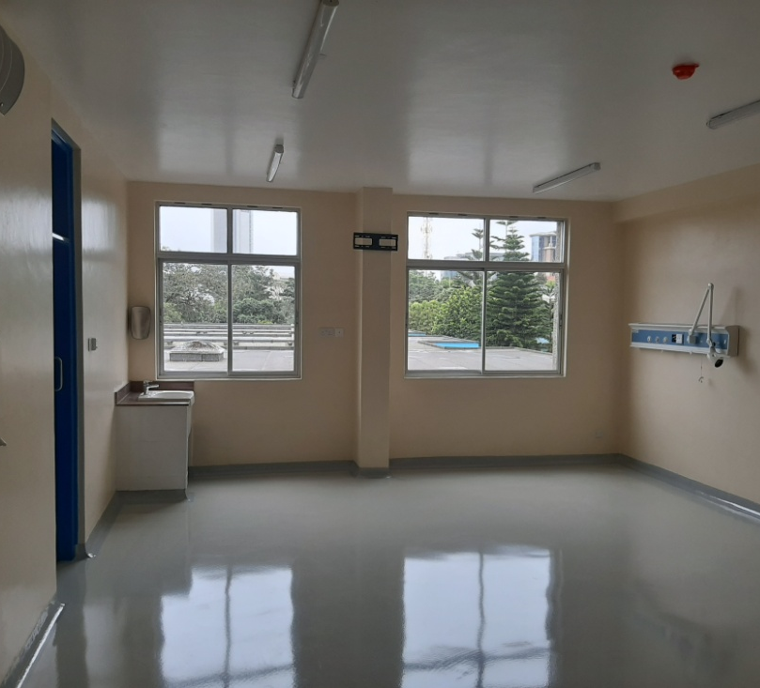
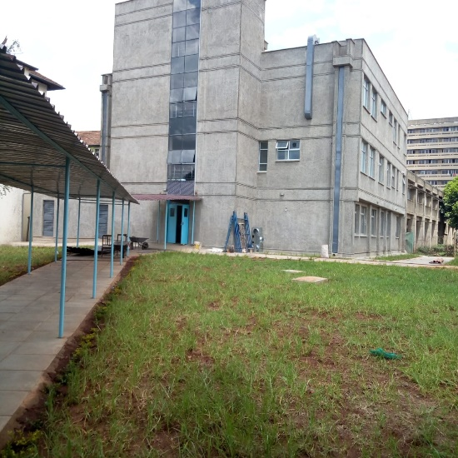
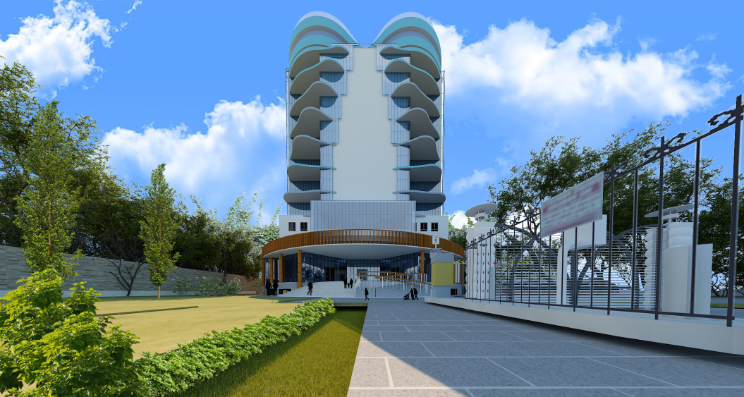
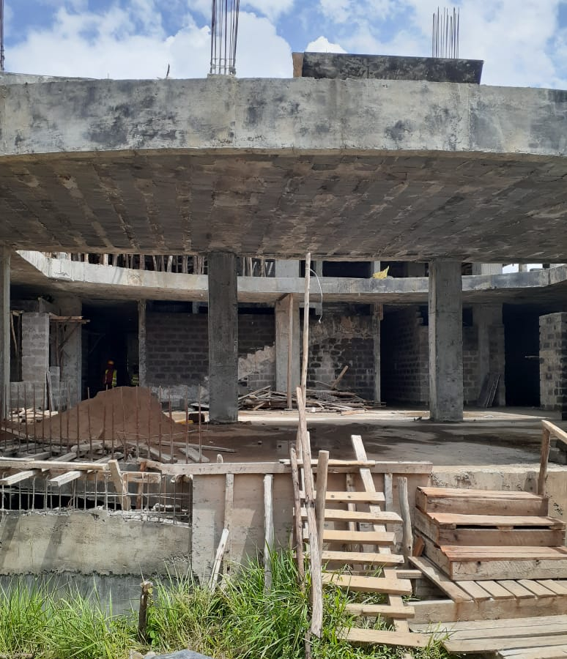
HEALTH PROJECTS
Extension To The Renal Unit, KNH
The project entailed construction of transplant theatres and support facilities for the renal unit and was to serve all other organ transplant. While the interior is modern, the architectural language was to match the existing hospital built in the 80s.
Cancer Treatment Centre, KNH
Mitunguu Cancer Centre, Meru
The 11 storey building was designed as a 500 bed cancer centre but implemented in phases. Human centred, therapeutic healing spaces with focus on patient flow and infection control

Slide 7
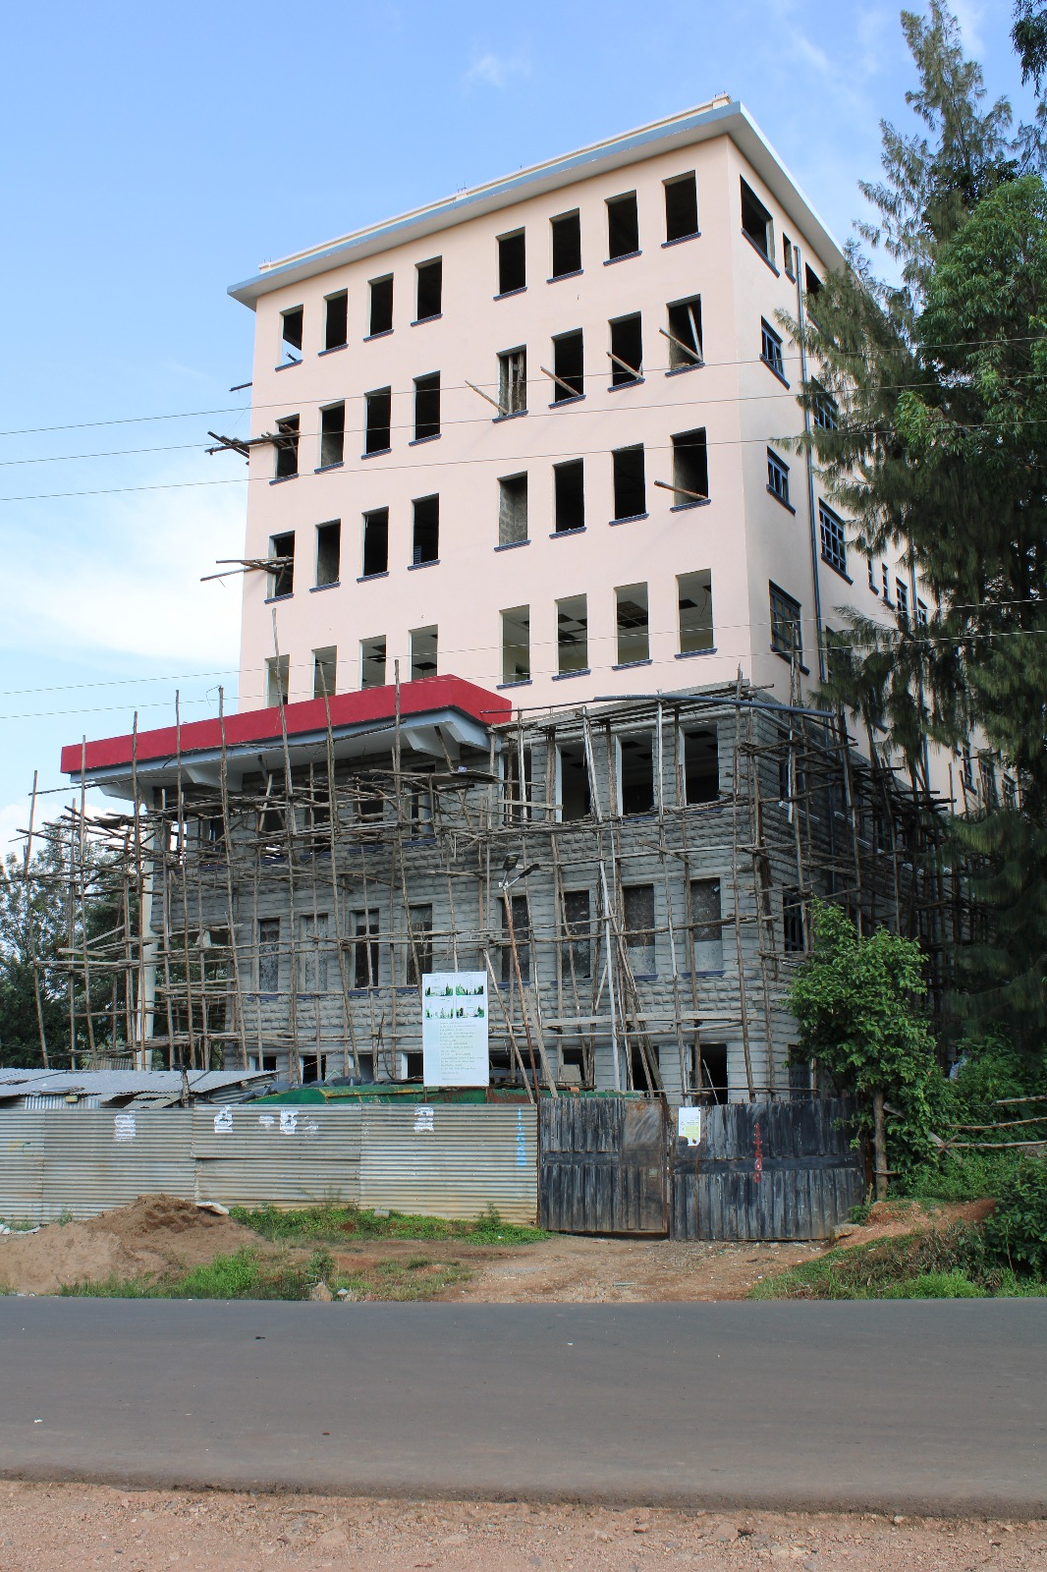
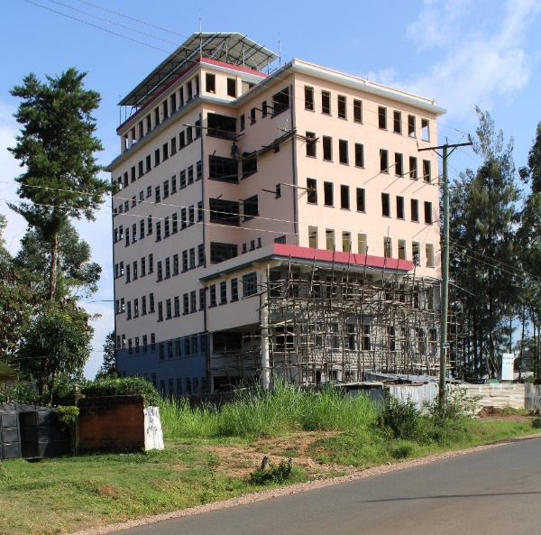
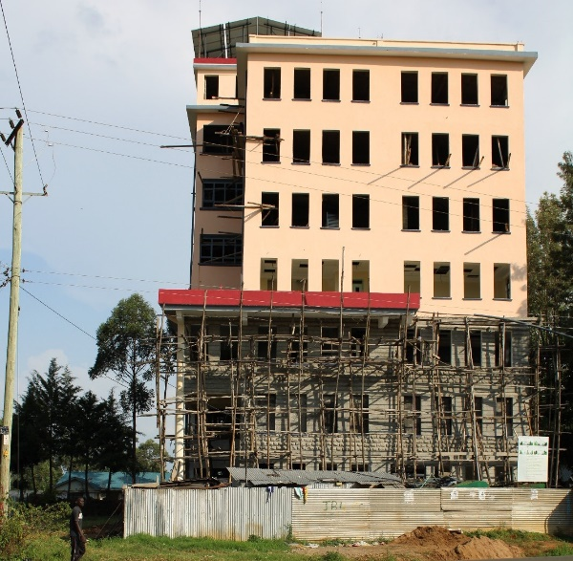
Kaka Medical Centre, Kakamega
The 7 storey private hospital in Kakamega will cater for inpatient, outpatient services, diagnostic services, renal services, operating theatres and an IC.

Slide 8
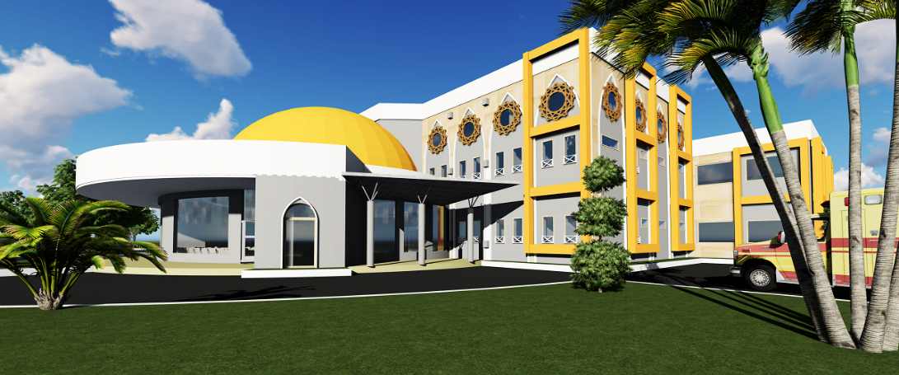
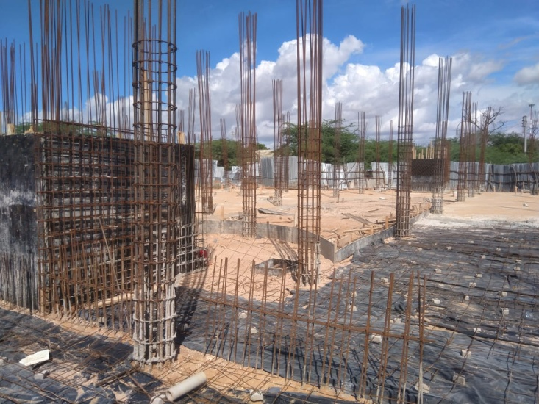
Garissa Cancer Centre
The cancer centre at the Garissa County Referral Hospital will cater for cancer patients from allover the North Eastern region of Kenya. The design depicts the Islamic architectural language.

Slide 9

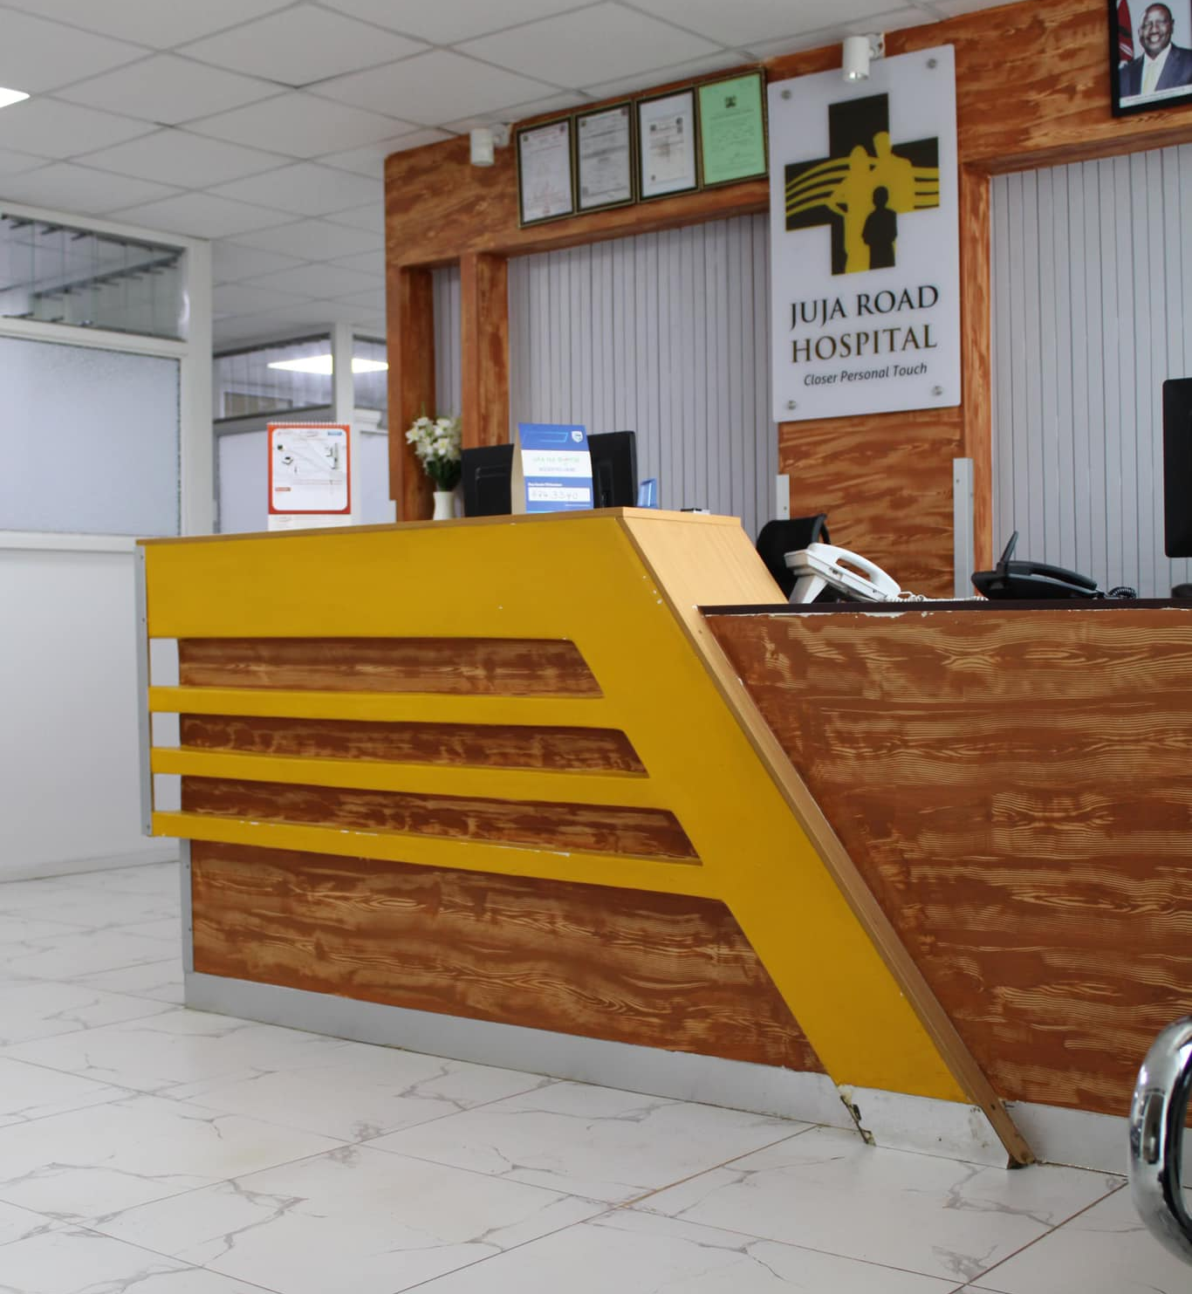
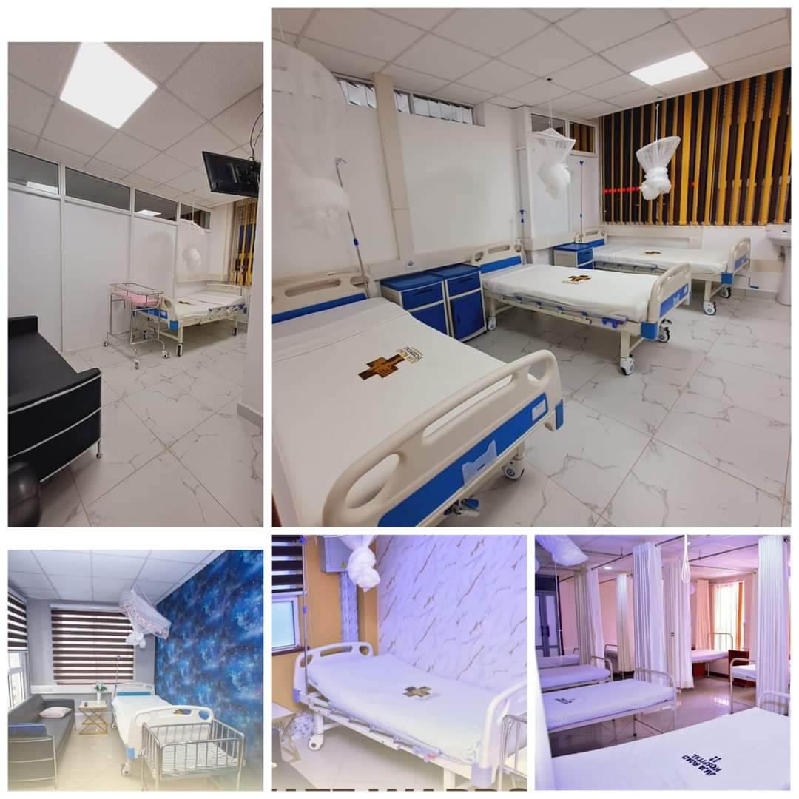
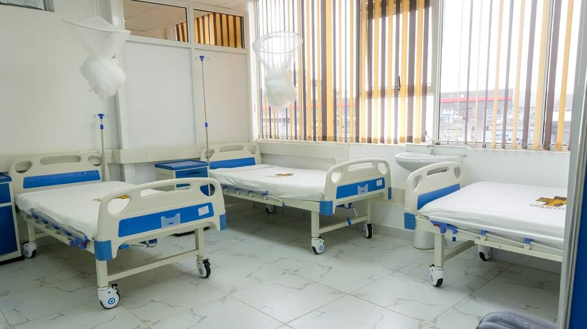
Juja Road Hospital, Ruiru
RPSA was tasked to retrofit an entire building block that was
initially designed as a commercial building into a functional and tastefully designed fully fledged hospital with a 25 bed inpatient capacity, complete out patient facilities, two modern operating theaters and an Independent Laboratory and Pharmacy.

Slide 10
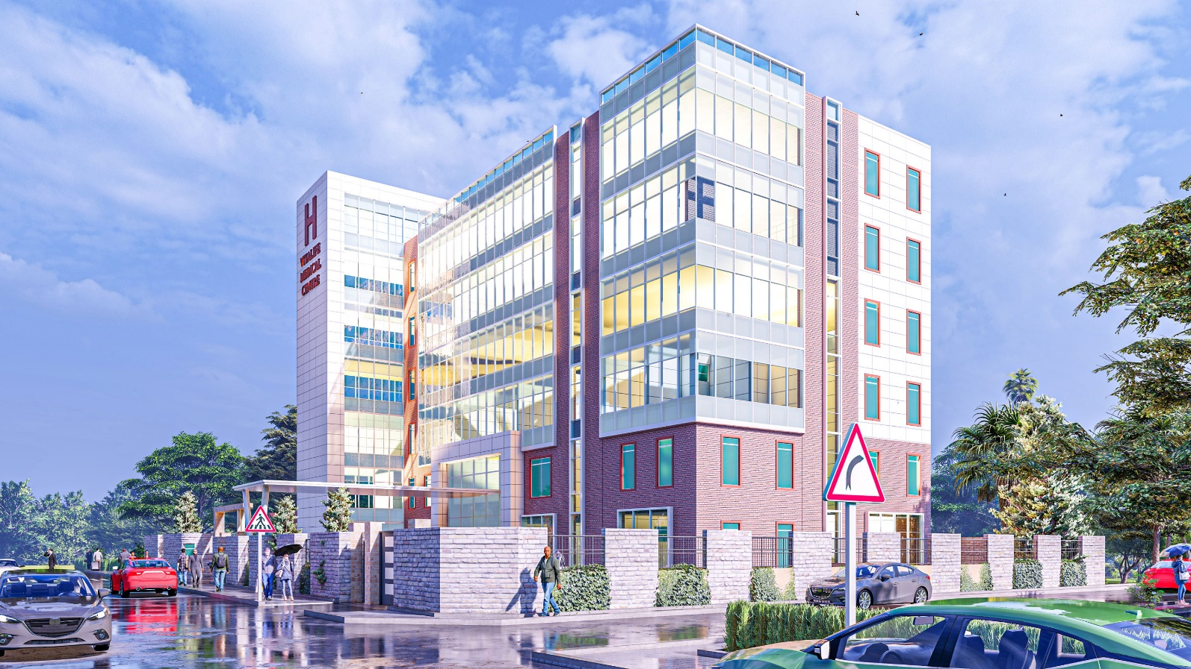
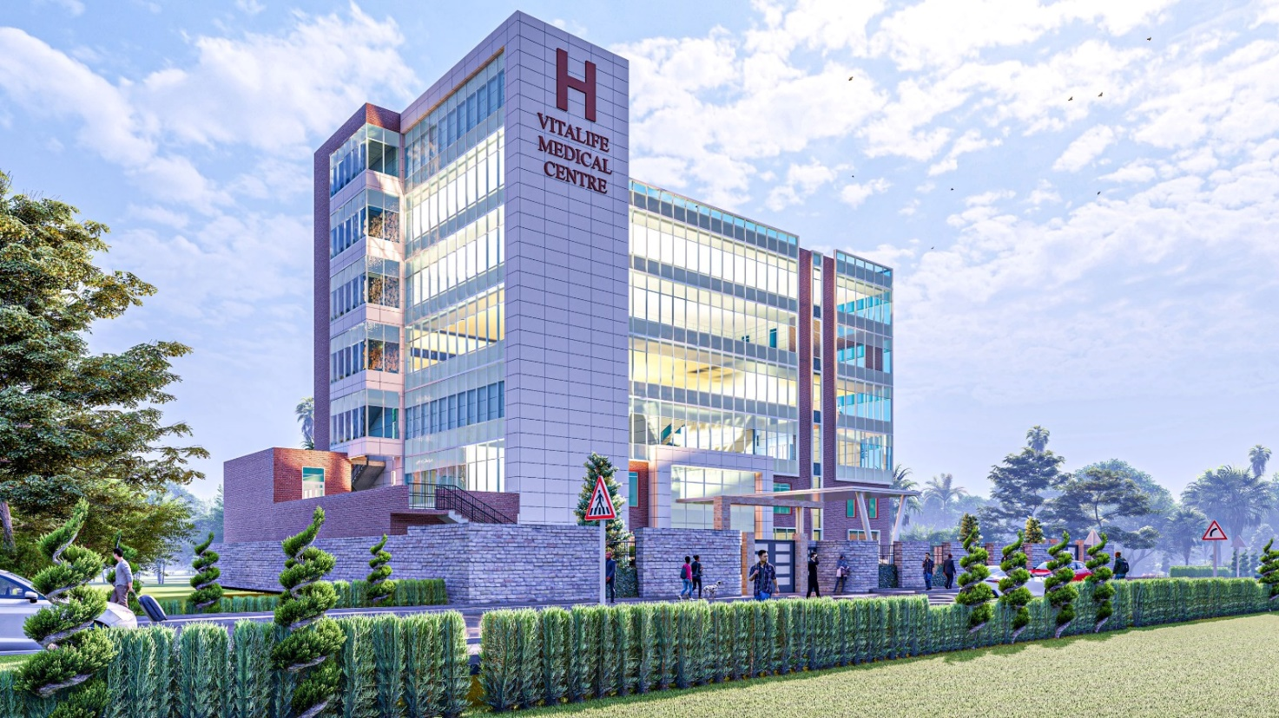
Vitalife Diagnostic Centre,
Juba, South Sudan
This first in the region ultra modern Diagnostic Centre is designed to have CT scan, MRI, X-Ray, ultrasound, Lab and other diagnostic services complete with all auxiliary facilities. It will also have a doctor’s plaza and consultant’s clinics.

Slide 11
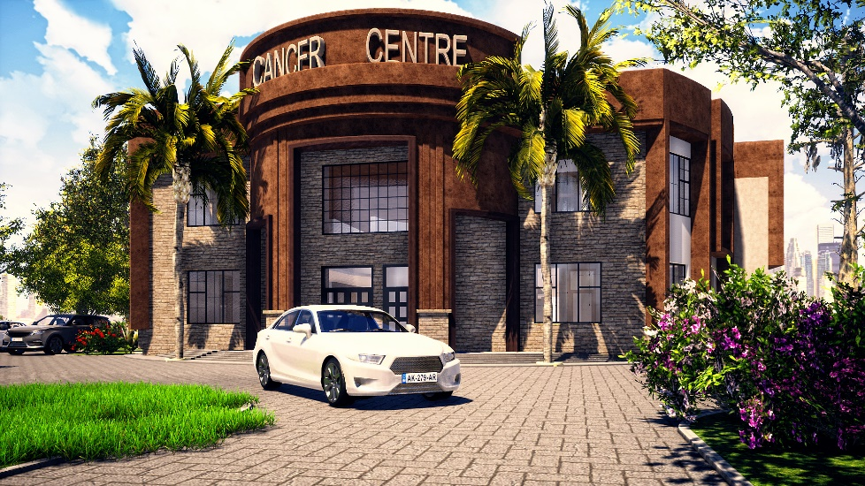
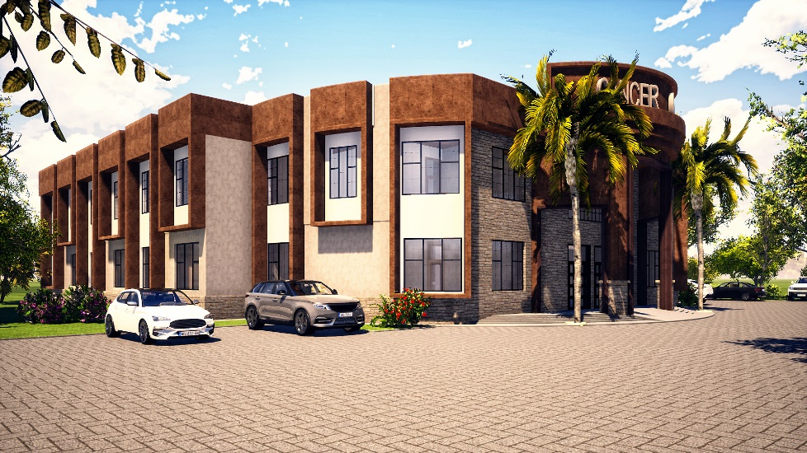
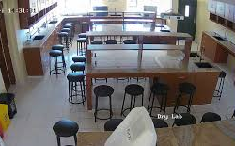
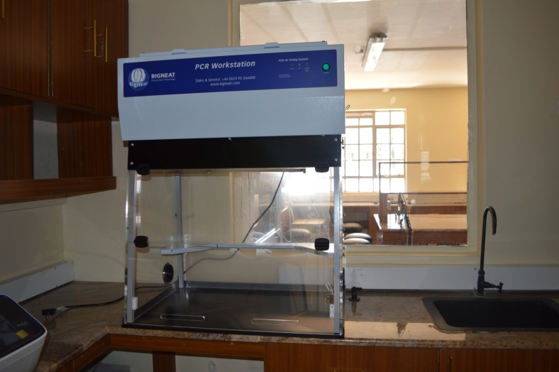
Mitunguu Cancer Centre
Cancer centre is designed to cater for the Meru region that has high rates of cancer. The facility is to focus on outpatient and chemotherapy services in the first phase with the second phase meant to incorporate radiotherapy and surgical services
Kirinyaga University Laboratory
The University converted two classes into science labs for the school of health sciences.

Slide 12
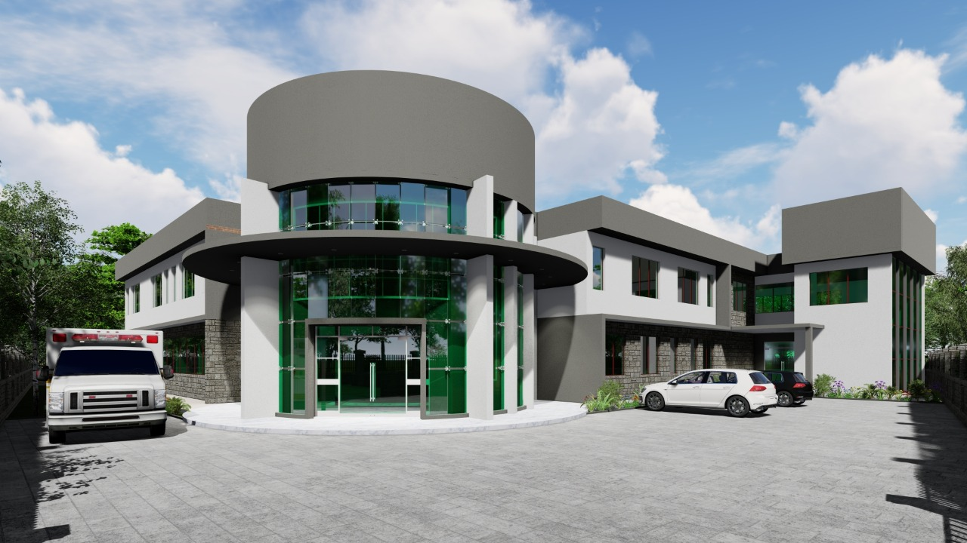
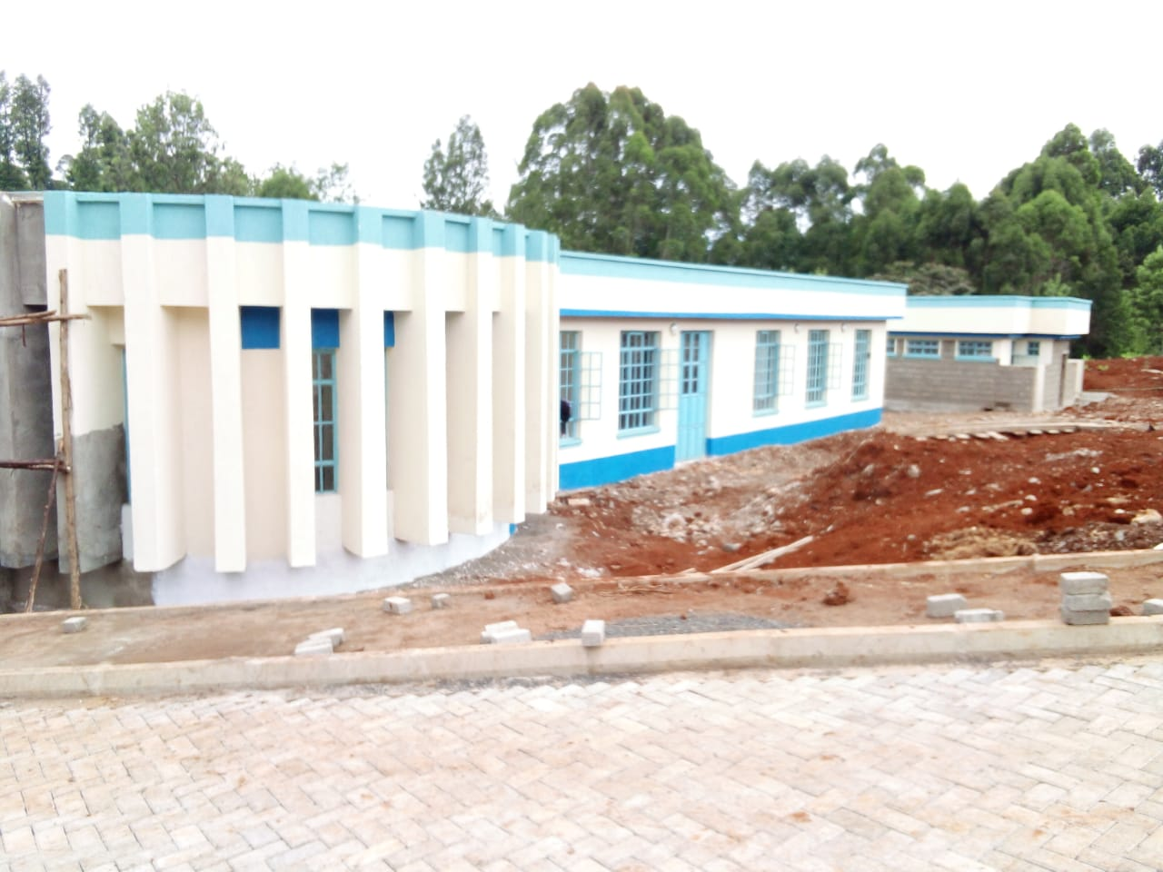
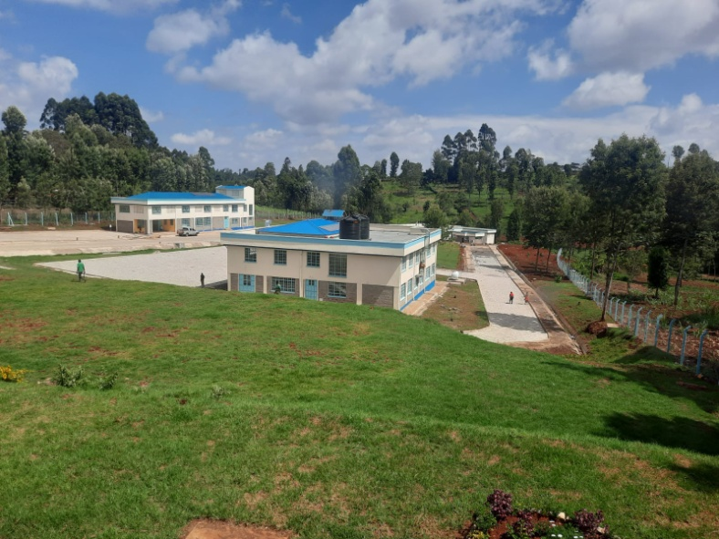
Kory Family Hospital, Kimilili
This building is an extension of the existing hospital in Kimilili The new wing of the hospital will have an outpatient, inpatient, diagnostic services as well as surgical facilities.
Expansion of Othaya Level 6 Hospital
The hospital was upgraded to a level 6 and needed support facilities such a morgue, laundry, kitchen and an oxygen plant. The task also included master planning.

Slide 13
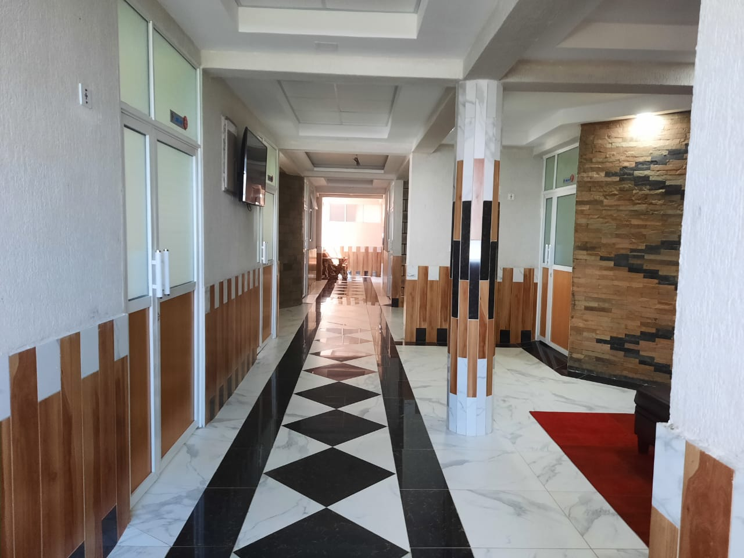
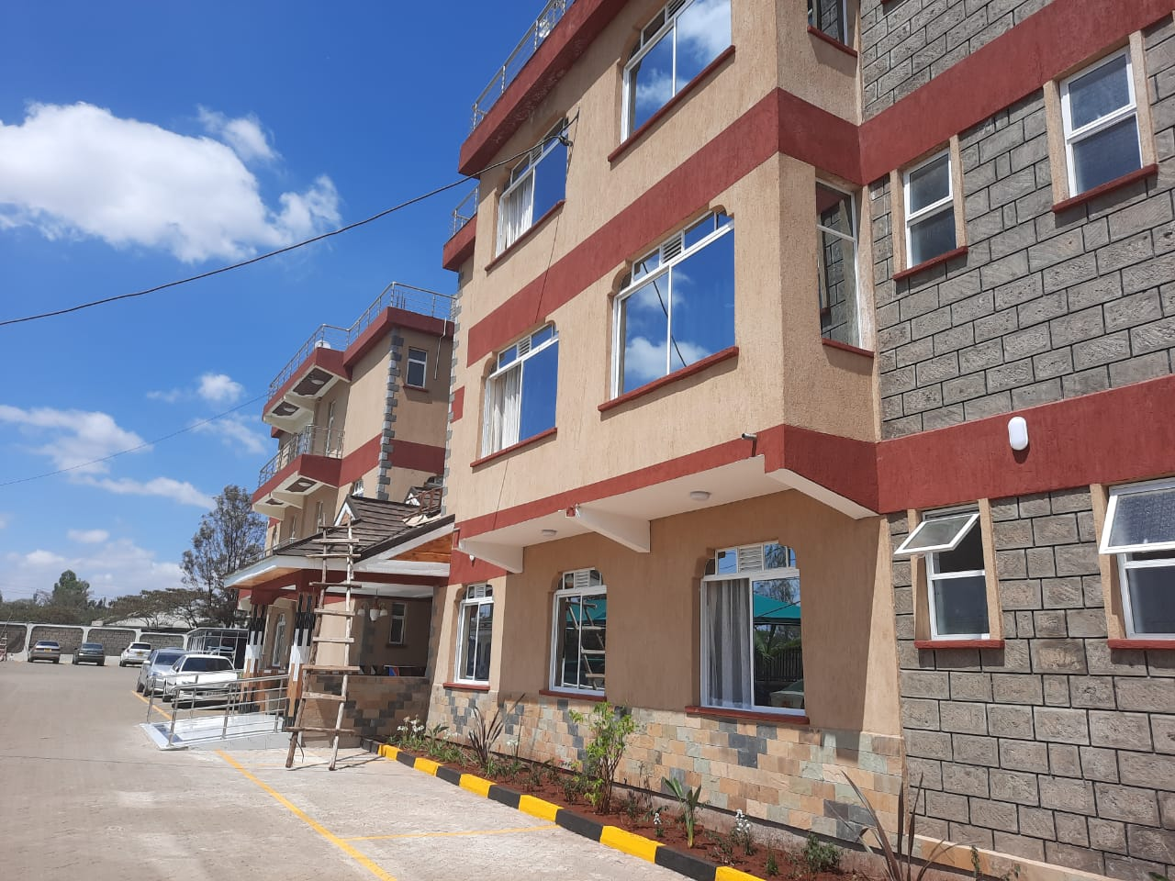
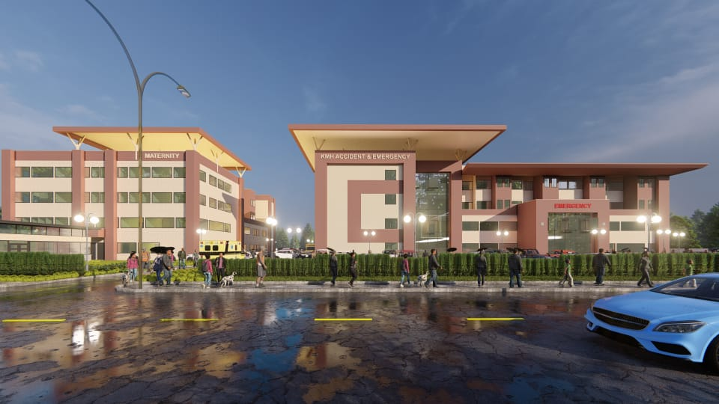
Komarock Modern Hospital, Utawala
The hospital needed re organization, expansion and master planning. The task was to reassign spaces, master plan and design new maternity, inpatient, accident and emergency, nursing schools, kitchen and laundry.
Komarock Modern Hospital, Kitengela
The new hospital will have an accident and emergency, maternity, inpatient, outpatient and associated facilities.

Slide 14
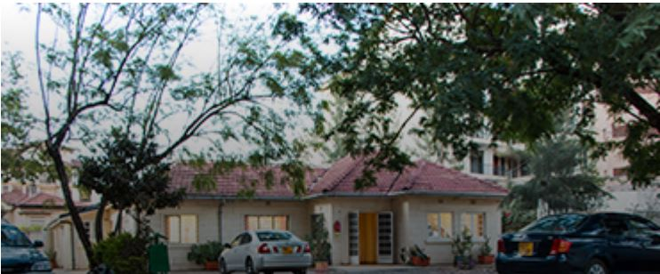
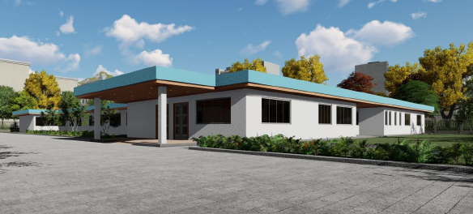
Nairobi radiotherapy Centre, Kilimani
Nairobi radiotherapy centre needed to move to a new facility to consolidate all their clinical spaces under one roof. This involved renovation of the facilities in Kilimani Nairobi
Model Emergency Centre
The design proposal was a model Emergency centre that can be fitted in any part of Kenya depending on the local prevailing circumstances and requirements. It was done for the Emergency Medicine Foundation Kenya. We have also been involved in renovation of Migori, Bungoma, Mbagathi and Voi County Hospital emergency departments.

Slide 15
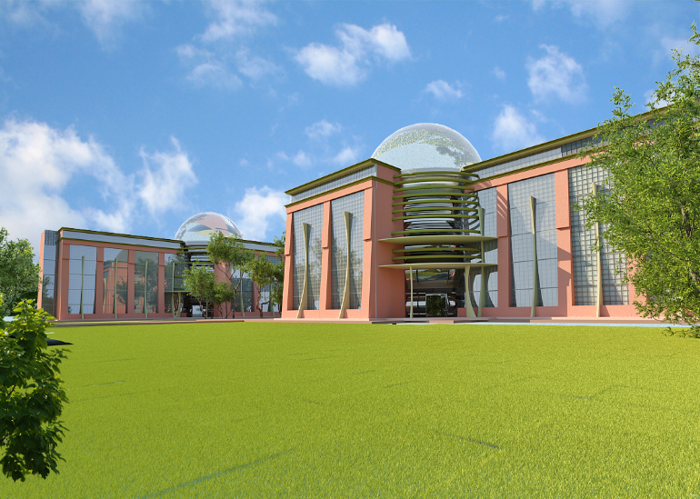
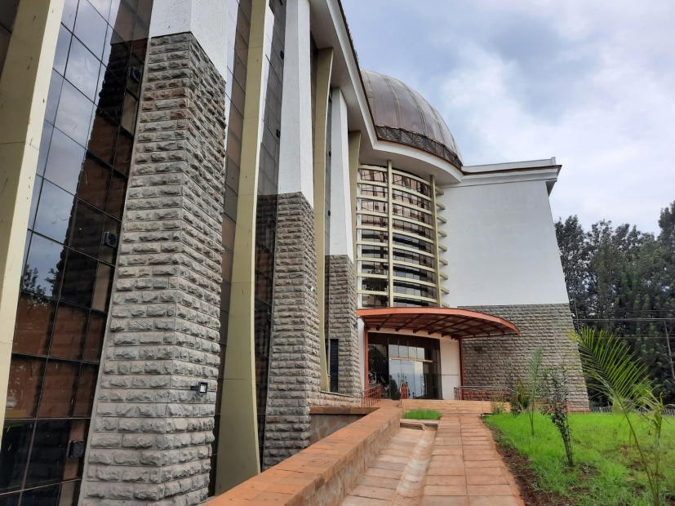
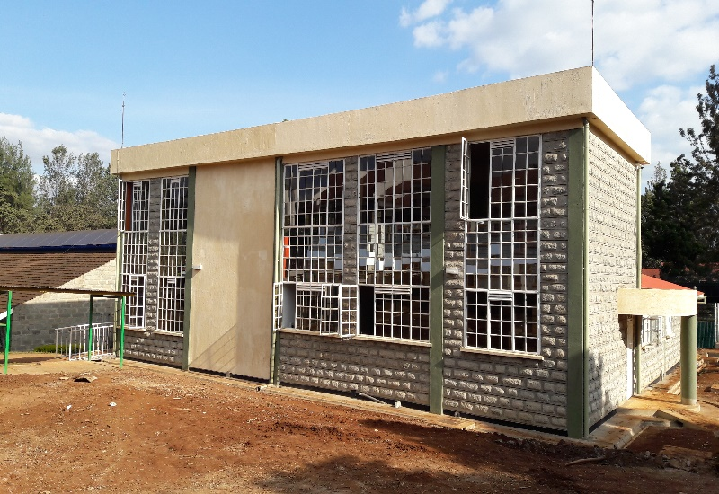
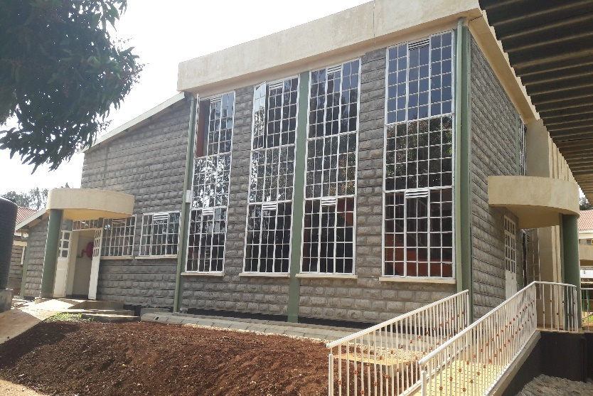
INSTITUTIONAL PROJECTS
Kirinyaga University Tuition Complex
Kirinyaga University Dining Hall
Kirinyaga University Science Labs

Slide 16
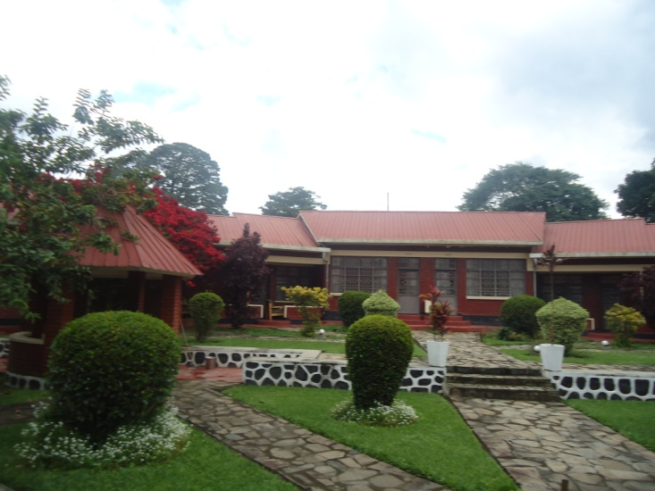
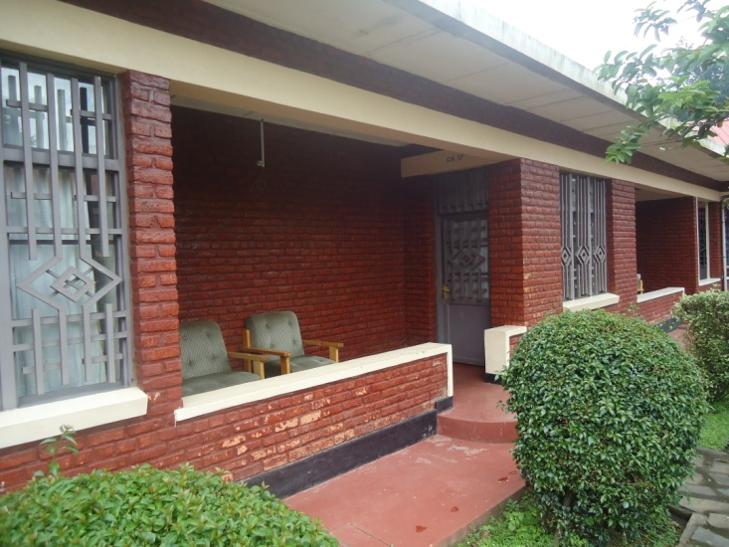
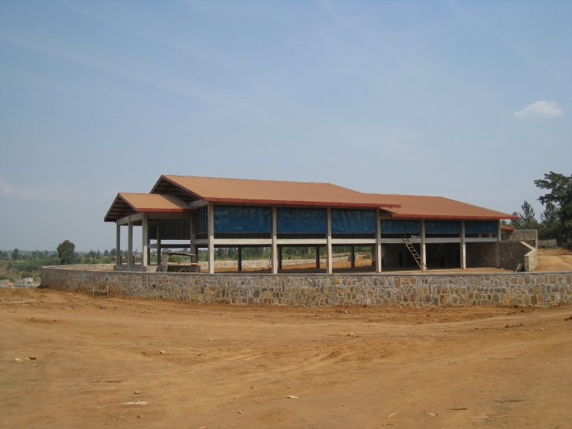
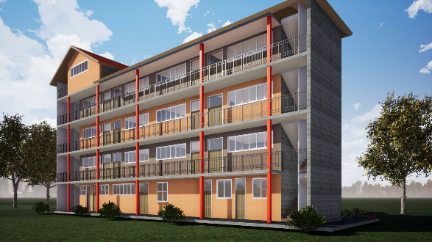
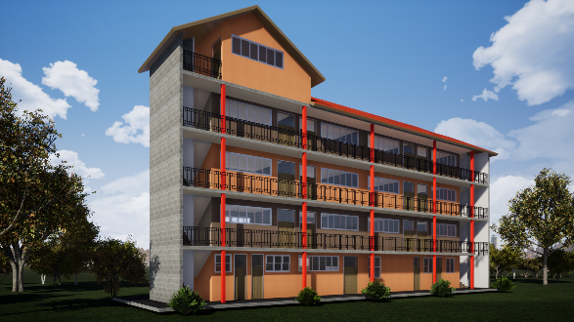
Renovation Of TIVET Schools In Rwanda
Gashora Girls Academy , Bugesera
Proposed Doonholm SDA primary school

Slide 17
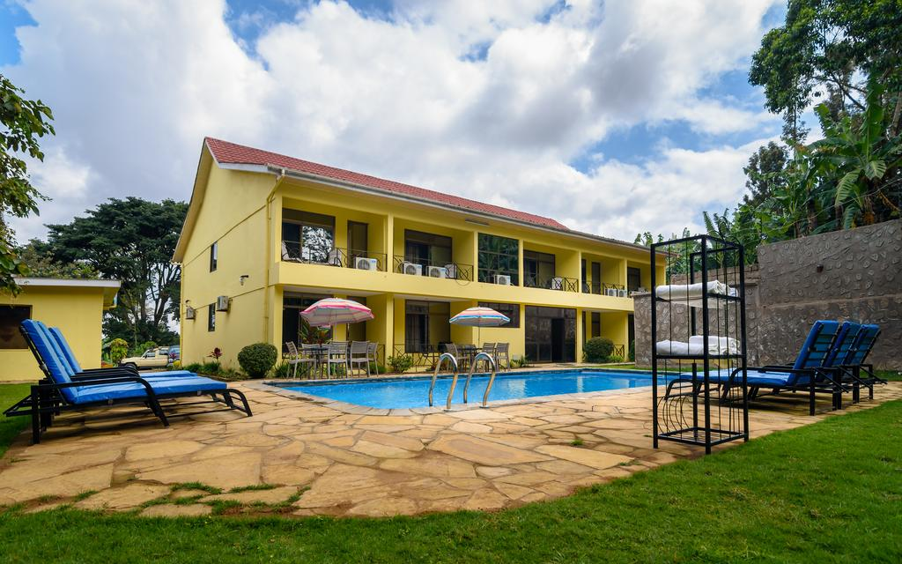
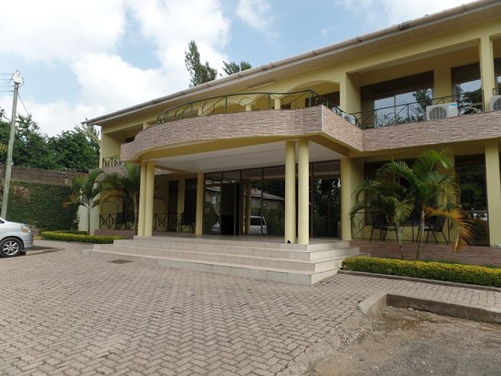
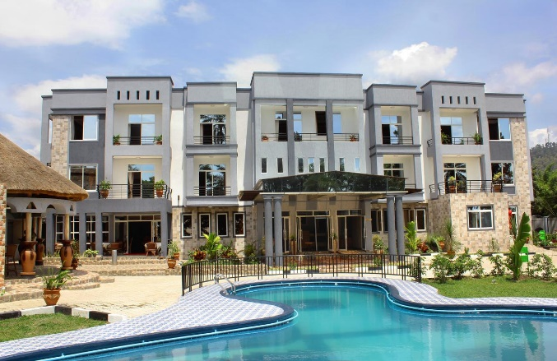

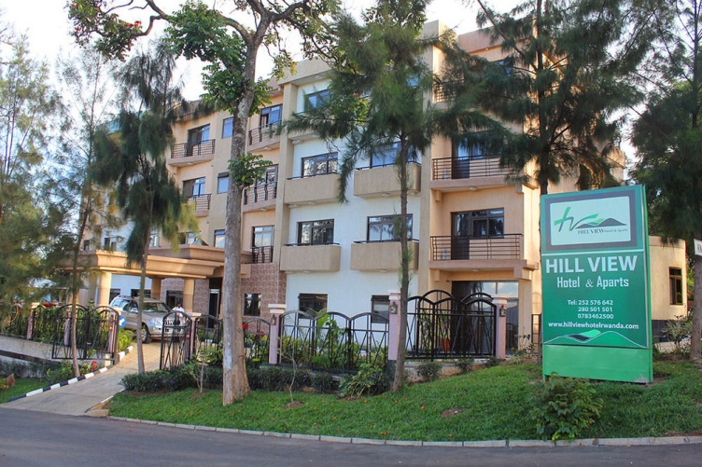
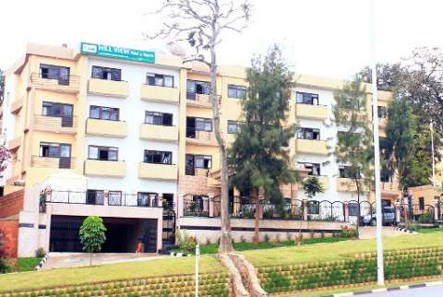
HOSPITALITY
Mvuli Hotel, Arusha
Hillview Hotel, Gisenyi
Hillview Hotel, Kigali

Slide 18
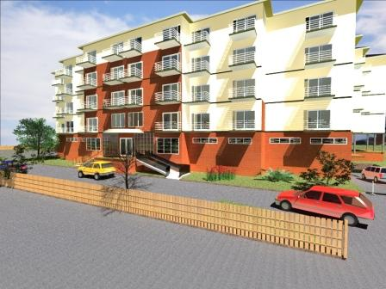
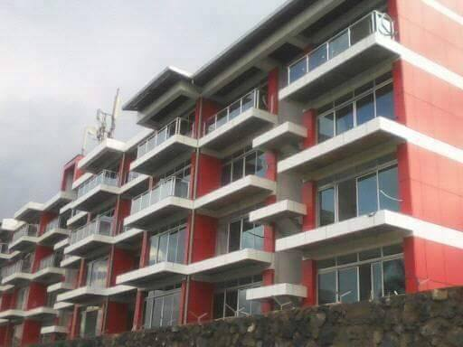
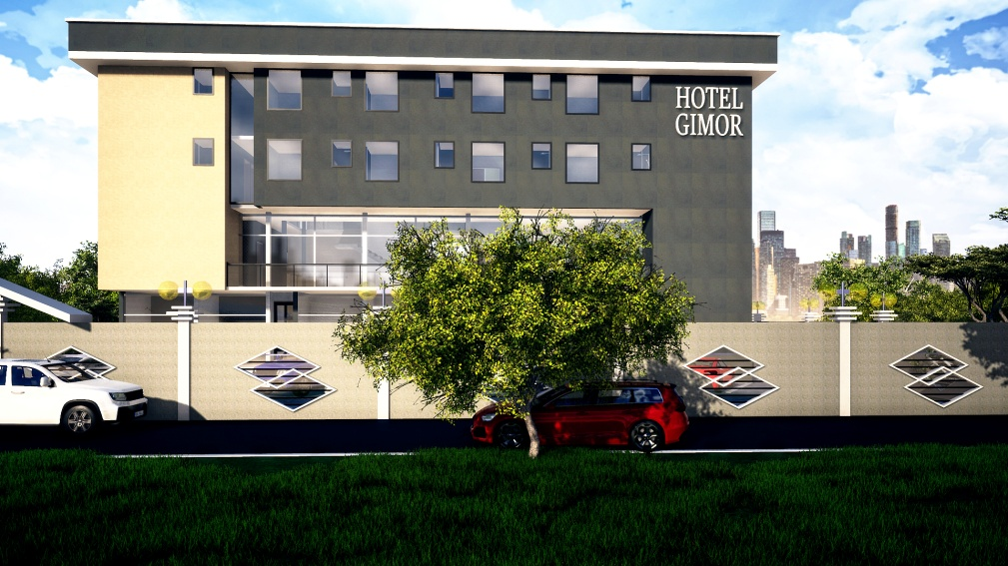
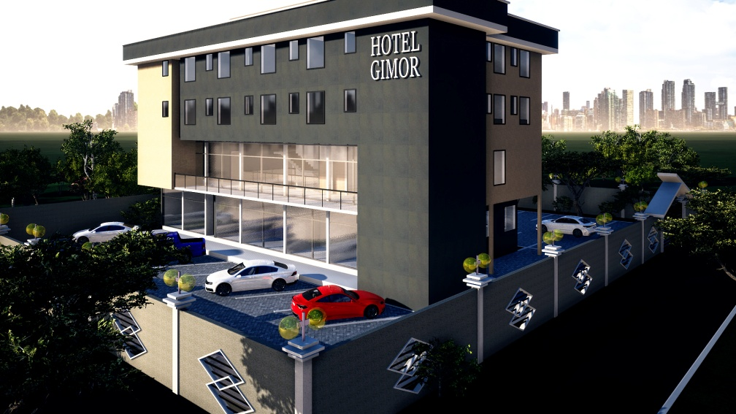
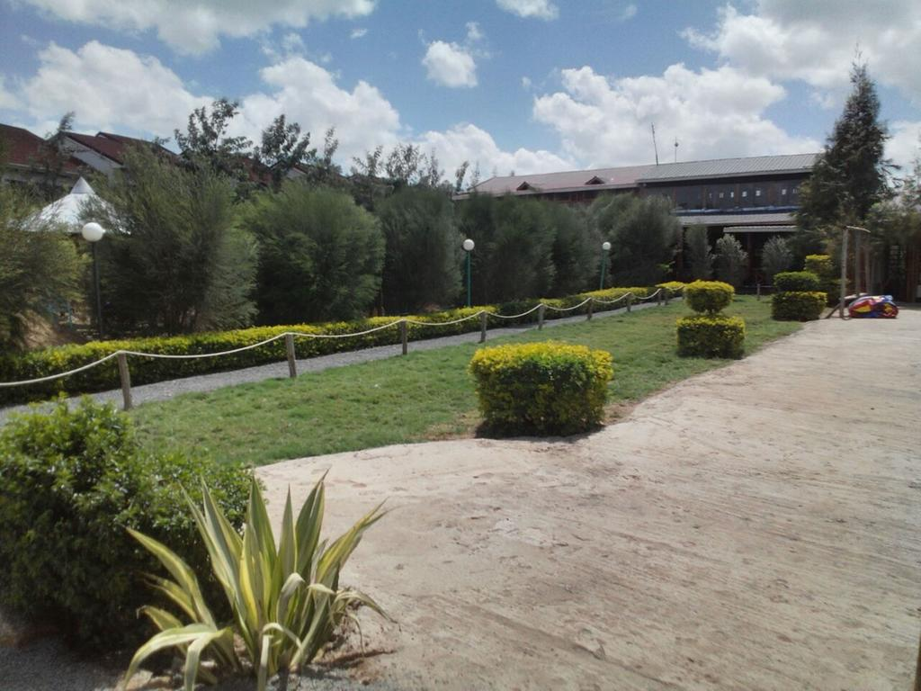
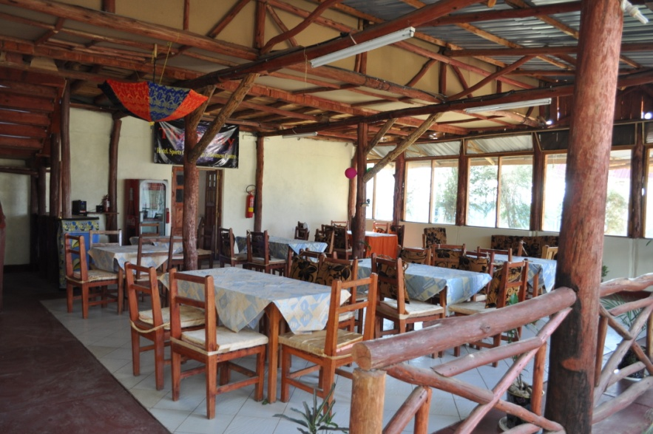
Hotel Riviera, Goma, DRC
Proposed Homabay Gimor Hotel, Rodi
Galaxy Inn, Athi River

Slide 19
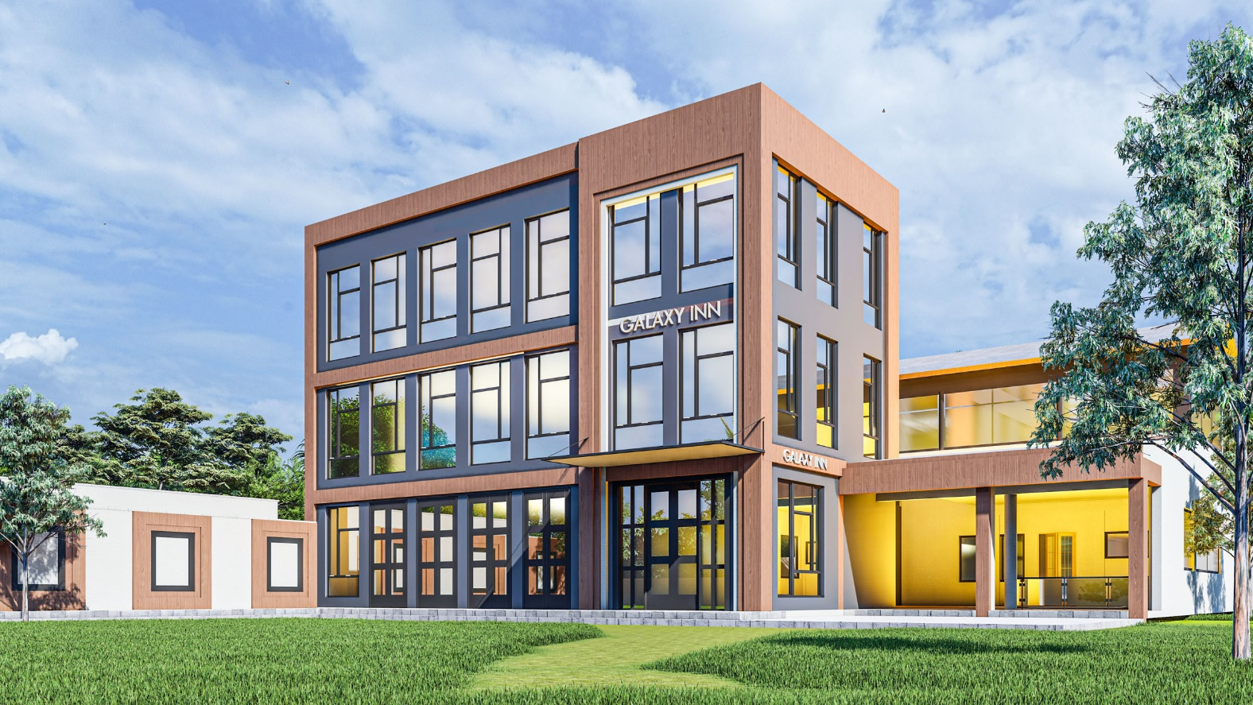

Galaxy Inn Conference and Exhibition Centre
Galaxy Inn Conference and Exhibition Centre was the third phase of the Galaxy Inn hospitality development. It houses an extensive exhibition center on the ground floor, which can be extended into the adjacent grass lawn, Stately conference rooms on the first and second floors overlooking the green yard below and a restaurant on the side.

Slide 20


RELIGIOUS
SDA Church Donholm
The donholm SDA Church was designed with a convenient ground level parking, Main church sitting on the first floor, unobstructed gallery seating on the second floor, Offices and all other necessary support spaces.

Slide 21


RELIGIOUS
Kasarani Sportsview SDA Church
Project : SDA Church Sportsview
Currently in construction stage as of April, 2024, this 700 seater house of worship was elegantly designed with a convenient ground level parking, Main church sitting on the first floor, unobstructed gallery seating on the second floor, Offices and convenient inclusive architecture elements such as the Mothers’ room, disabled toilet, baby changing room, children’s toilet among others.

Slide 22


RESIDENTIAL PROJECTS
8 no 4 bedroom town houses in Rongai
4 bedroom bungalow in Siaya

Slide 23




RESIDENTIAL PROJECTS
Contemporary 5 bedroom all ensuite Mansion in Kerarapon

Slide 24


RESIDENTIAL PROJECTS
Israel Apartments, Machakos
This is a one and two bedroom apartments block in the heart of Machakos Town, tastefully designed to offer accommodation for the sprouting town’s middle class. It includes a basement parking, frontage commercial stores, residential units and a resident’s gym on the top floor.

Slide 25



4 bedroom bungalow in Siaya.
This residential unit in Siaya boast of 4 well designed bedrooms; two ensuite; two sharing; A visitors cloak room; semi open kitchen opening into the dining room; spacious and lounge and a characteristic entry porch.

Slide 26



Katani 5 Bedroom Maisonette
This residential unit boasts of 5 bedrooms all ensuite; spacious double volume lounge, semi open kichen opening to the dining room, private gym on the top level among other eye catching elements.

Slide 27



Syokimau Apartments
These are two and three bedroom apartments in Syokimau, tastefully designed to offer accommodation for the sprouting town’s middle class. It includes ground floor parking, commercial scale lifts, residential units and a resident’s gym on the top floor.

Slide 28





4 bedroom residence in Kiambu.
Apartment complex in Embu
Modern 5 bedroom house in katani

Slide 29






Residential House , Karen, Nairobi .
Proposed Attic House, Rongai
4 bedroom residence in Siaya.
4 bedroom residence in Kiambu.
Residential Apartments, Machakos.
Residential apartments in Homabay.

Slide 30
Renaissance Per salut Architects Ltd
Architects, Interior Designers and Project Managers
Client Service Charter
As our Client you can expect :
High quality, Client focused services in Architectural Design and Project management.
Open, courteous and respectful treatment
Clear, accurate and timely information on Client Projects through detailed project briefs, design team minutes, site meeting minutes and project management reports.
Consistent service at times and venues convenient to the Client.
Equality in service provision, free from any form of discrimination.
Prompt and efficient response to Client complaints
Respect of Client confidentiality and sensitivity to personal information.
Strict adherence to this Client Service Charter

Slide 31


Slide 32


Slide 34


Slide 35


